Slide 1
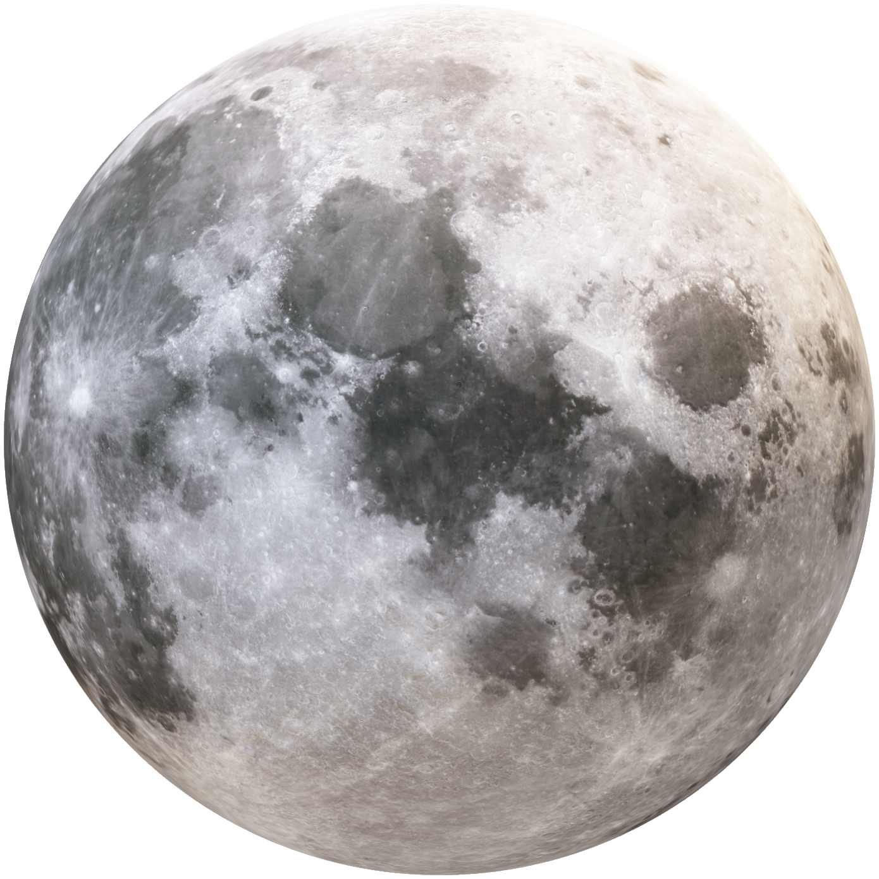

Destination:
The Stars
Physics, Physical Science

Slide 2

SpaceX needs your help building a space craft to reach the stars.

Slide 3
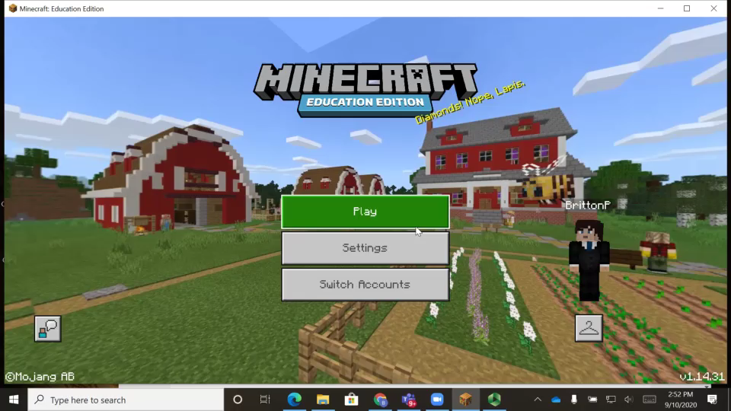

Slide 4

Today you will be assisting top scientists in creating a rocket
to go on extended trips to space, perhaps even mars.
Your Space Traveling ship must have the following three rooms, you may add more;
Command room – So the ship can be controlled
Sleeping quarters – so the crew has a place to sleep
Hydroponics bay – a place where crew members can grow their own food

Slide 5
If students need to download Minecraft education edition to their personal device.
Go to
https://education.minecraft.net/get-started/download

