Slide 1
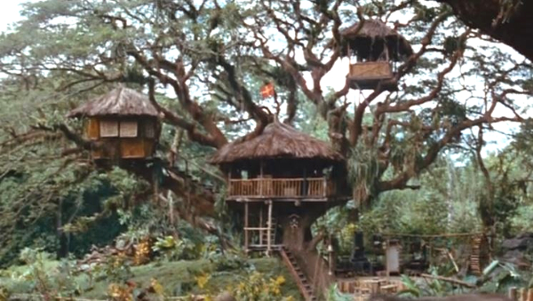
Tree Top Town
Subtitle

Slide 2
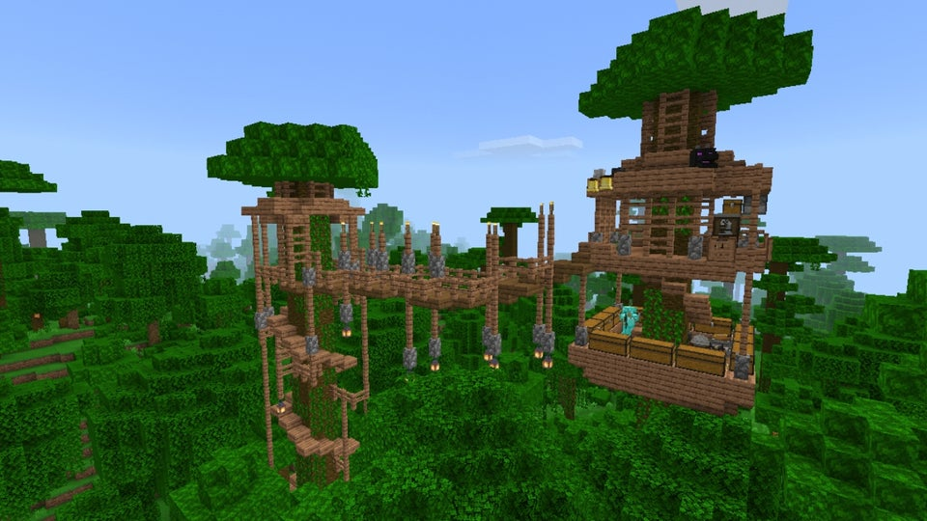
A City in the Trees
For this building session you will be building a town in the trees.

Slide 3
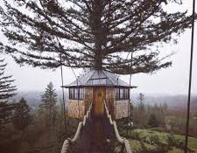
Each city needs to have the following
A city Hall
Four tree houses or more (each has must be livable)
Walk ways/transit system to connect the houses
You must not destroy any trees while building your houses (the Environmental Protection Agency will revoke your building permits)

Slide 4
Instructional video (the link is on the last slide)

Slide 5
Copy and paste to chat
Each tree top town must have the following
A city Hall
at least Four tree houses (each house needs be livable, bed etc.)
Walk ways/transit system to connect the houses
You must not destroy any trees while building your houses (the Environmental Protection Agency will revoke your building permits)

